Slide 1

Software Engineering
Software Project Management, Architecture & Design
Software Design
Department of Computer Science and Engineering
Acknowledgement: Authors of the prescribed textbooks and materials sourced online.

Slide 2

Software Design
List of Contents
Design Methods
Data Flow Diagrams (DFDs)
Top Level DFD
First Level Decomposition
Second Level Decomposition
Minispecs
Data dictionary entries
Transform Centred Design
Design Pattern
Singleton Pattern
Anti Pattern
Department of Computer Science and Engineering
‹#›

Slide 3
Design Methods
Detailed design methods support us in decomposing the components representing the system requirement into components/subcomponents well. Example: DFD, Booch, Fusion
Data Flow Diagrams (DFDs)
Developed by Yourdon and Constantine in early 70s
It is a two-step process:
• Structured Analysis (SA), resulting in a logical design, drawn as a set of data flow diagrams
• Structured Design (SD) transforming the logical design into a program structure drawn as a set of structure charts

Slide 4
Components in DFD
External entity
Source and Destination of a transaction
Processes
Transforms the data
Data Stores
These lie between processes & are places where data structures reside
Data Flows
Paths where data structures travel between processes and entities and data stores
External entity
Depicted as squares
Processes
Depicted as circles
Data Stores
Depicted as two parallel lines
Data Flows
Depicted as arrows
Structured Analysis (SA) results in a logical model, consisting of a set of DFDs augmented by minispecs & data dictionary
Structured Design (SD) results in transition of DFDs to hierarchical structure charts, most often as a transform-centered design

Slide 5
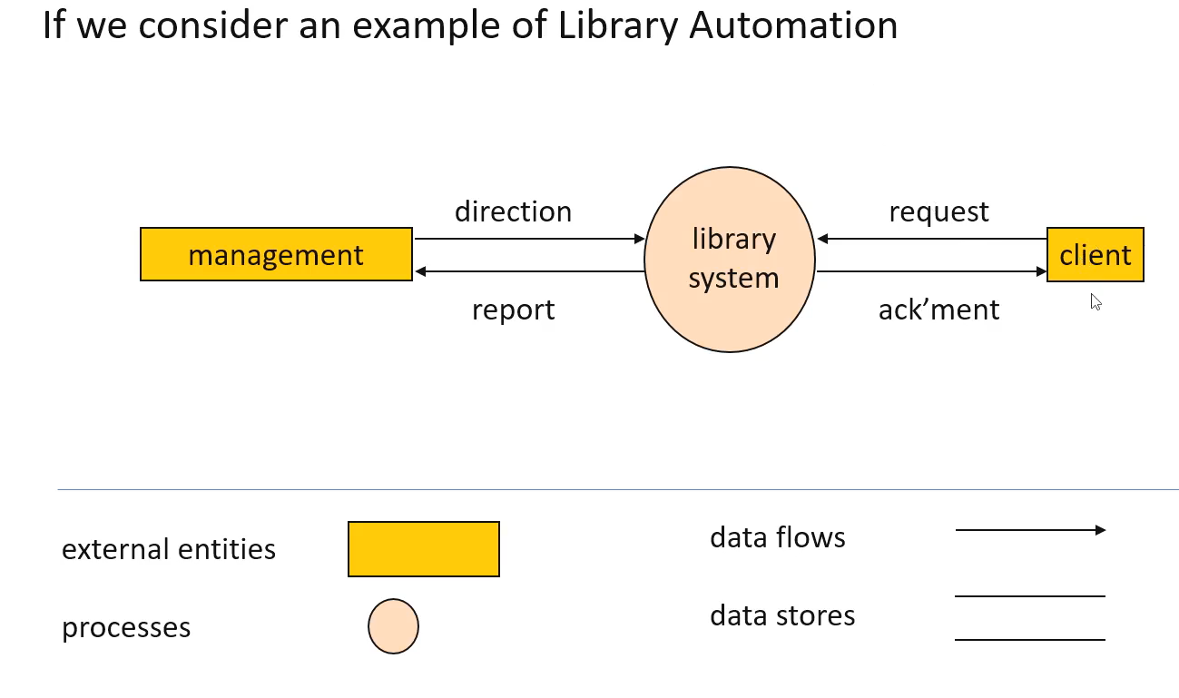
Top – Level DFD

Slide 6
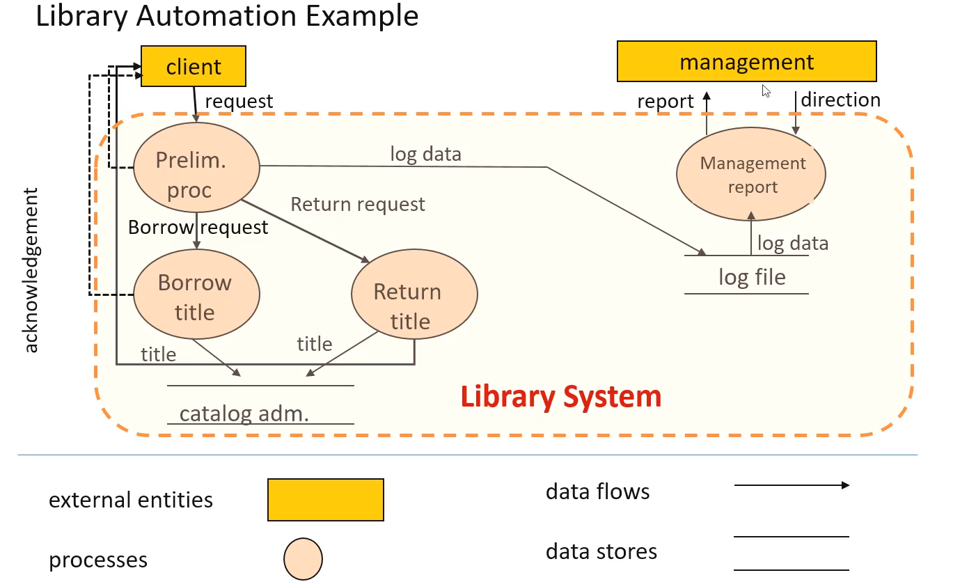
First Level Decomposition

Slide 7
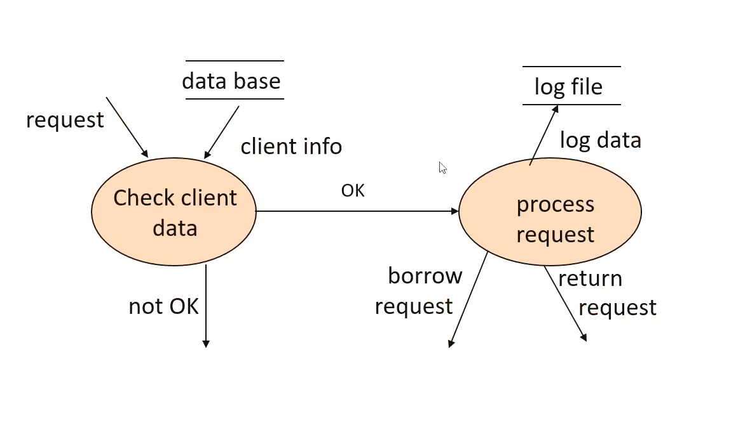
Second Level Decomposition

Slide 8
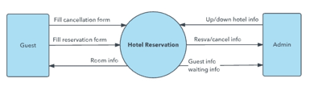
Hotel Reservation System - Level 0

Slide 9
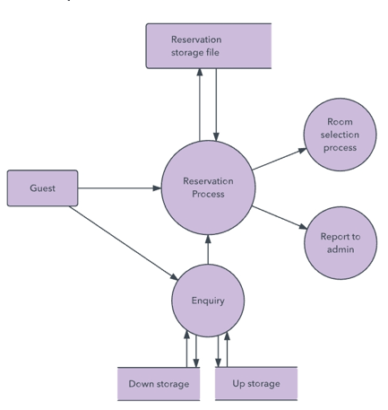
Level 1

Slide 10
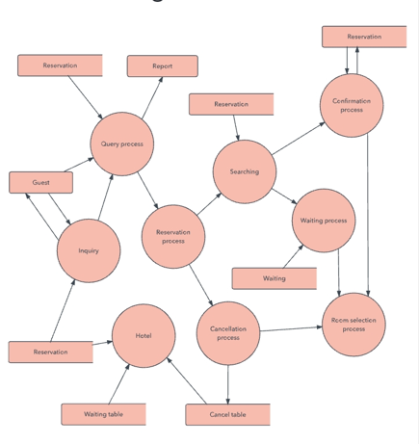
Level 2

Slide 11
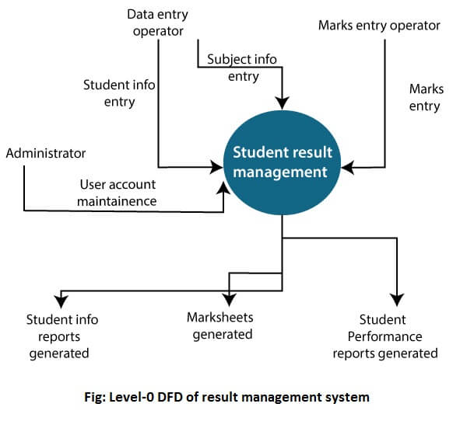
ResultManagement System

Slide 12
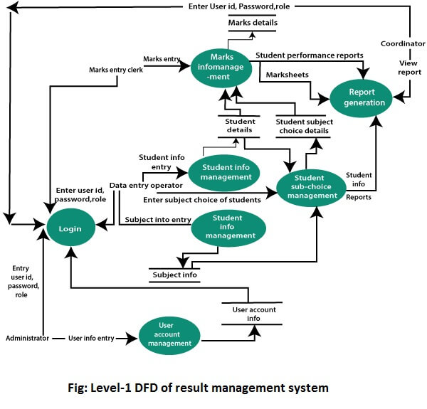
Result Management System

Slide 13
Result Management System

Slide 14
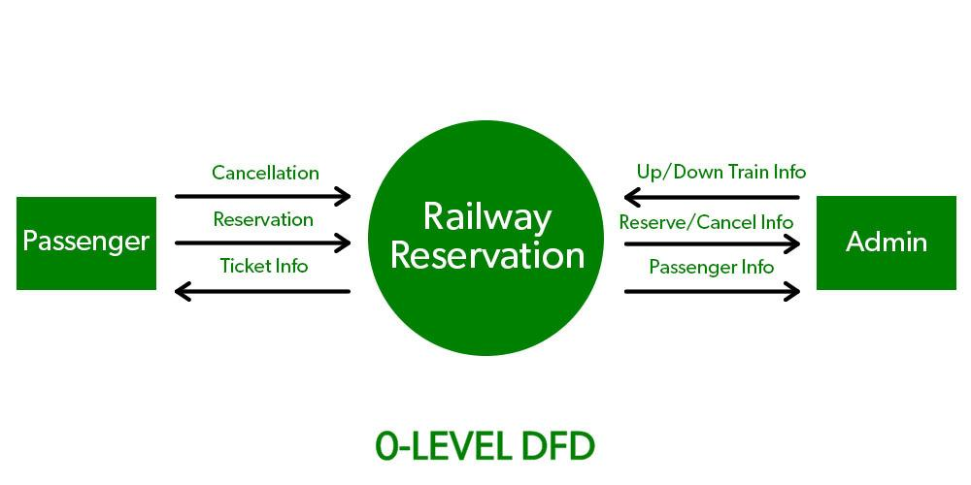
Railway Reservation System

Slide 15
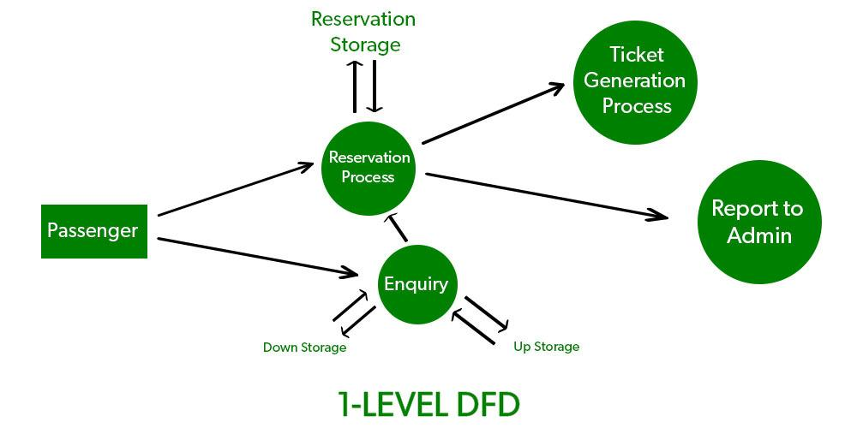
Railway Reservation System

Slide 16
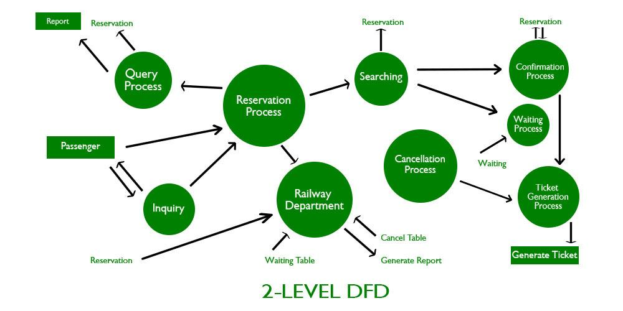
Railway Reservation System

Slide 17
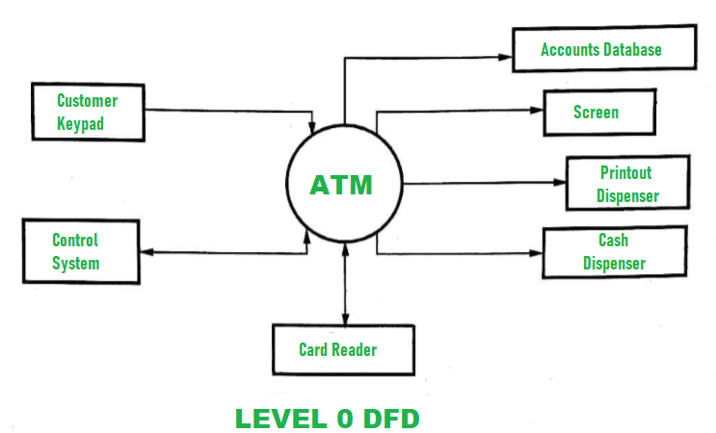
ATM System

Slide 18
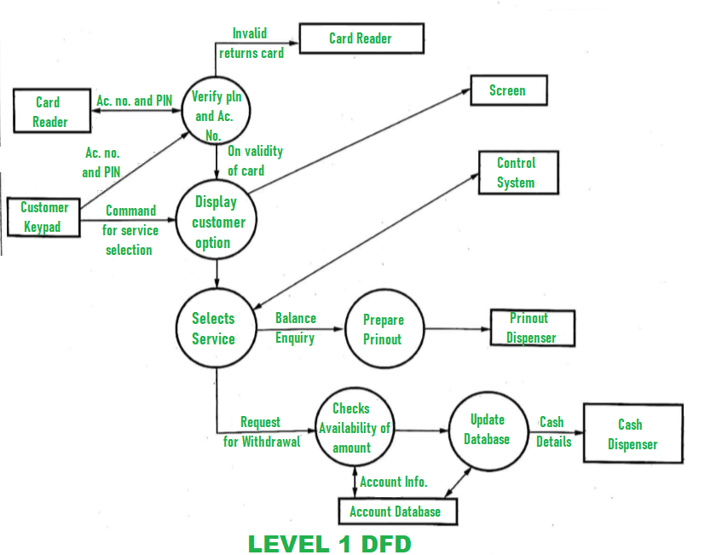
ATM System

Slide 19
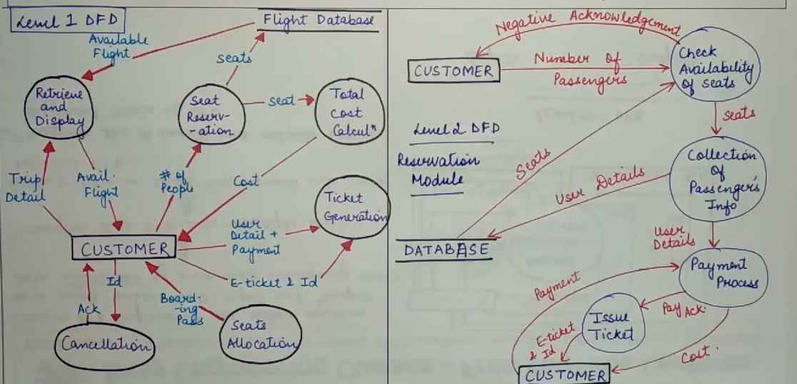
Airline System

Slide 20
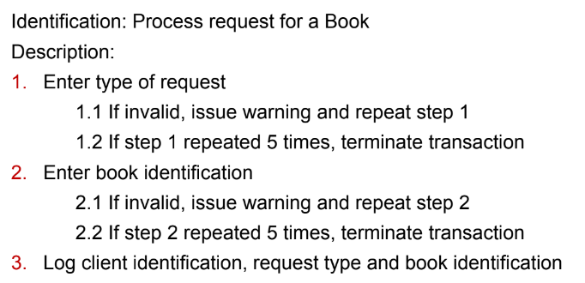
Minispecs
Once the process in DFDs become sufficiently straight forward and does not warrant further
decomposition, then these processes are described as “minispecs”
For example,

Slide 21
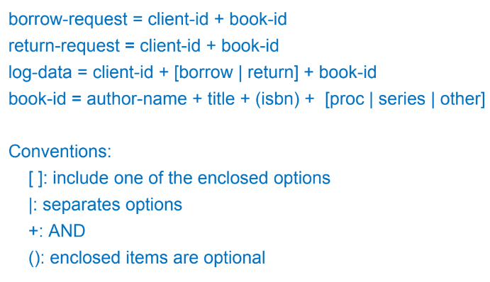
Data Dictionary Entries
The contents of the DFDs after we are at a logical decomposed state are recorded in a data dictionary. It is a precise description of the structure of data.
For example,

Slide 22
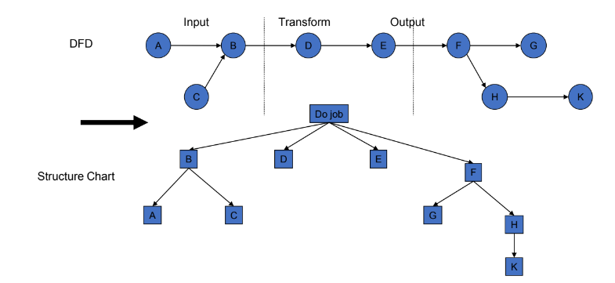
Transform – Centred Design
Trace the input through the data flow diagram until it can no longer be considered input.

Slide 23
Design Pattern
Design pattern provides solution to a recurring problem
Provides abstraction above the level of a single component
Provides common vocabulary and understanding for design principles
Design patterns are a means of documentation both descriptive and prescriptive
Structural decomposition
Types of patterns
Creational
Organization of work
Procedural
Object oriented
Structural
Access control
Behavioral
Management
Gang of Four
Distribution
Communication

Slide 24
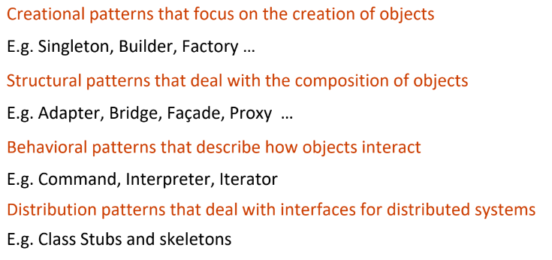
Detailed Information
Types of Design Patterns - https://www.youtube.com/watch?v=1004gyjLhkA

Slide 25
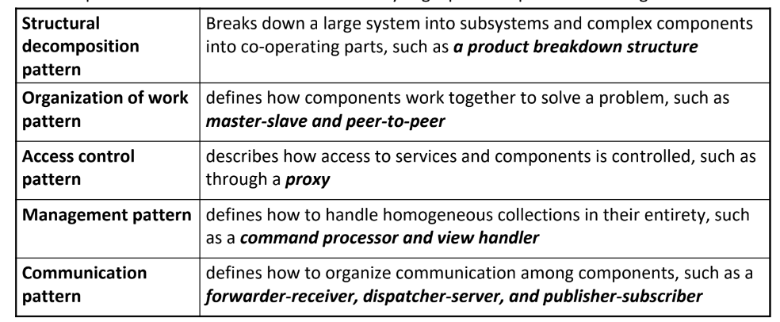
Detailed Information

Slide 26
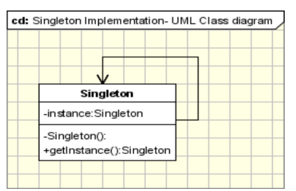
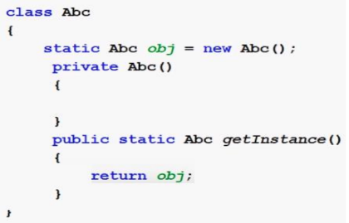
Singleton Pattern
Ensures that only one instance of a class is created
Provide a global point of access to the object. This is useful when only one object is needed to coordinate actions across the system.
It involves only one class which is responsible to instantiate itself.
The implementation involves a static member in the "Singleton" class, a private constructor and a static public method that returns a reference to the static member
ClientObj A
ClientObjB
ClientObj C
Singleton Object
Task

Slide 27
Anti Pattern
Patterns describe desirable behavior and anti patterns describe situations
one had better avoid
In agile approaches (XP), refactoring is applied whenever an anti pattern has
been introduced
Example,
God class: class that holds most responsibilities
Lava flow: dead code which gets carried forward indefinitely
6 types of Antipatterns to avoid in Software Engineering: https://www.youtube.com/watch?v=njdaMBqquos

Slide 28
Six Types of Anti Patterns
1. Spaghetti Code
Code with a tangled, unstructured control flow that is hard to follow and maintain.
Example: Using numerous goto statements leading to a confusing, non-linear flow of execution.
2. Golden Hammer
Applying a single tool or technology to all problems, regardless of its suitability.
Example: Using a relational database for every application, even when a NoSQL solution would be more appropriate.
3. Boat Anchor
Retaining obsolete or unnecessary components that are no longer needed, but are kept due to their historical significance.
Example: Continuing to use a legacy library for new development when it’s been superseded by more efficient alternatives.

Slide 29
Six Types of Anti Patterns
4. Dead Code
Code that is never executed or used, which adds unnecessary complexity and can lead to confusion.
Example: A function in a codebase that is never called by any other part of the program.
5. God Object and God Class
An object or class that performs too many functions and handles too many responsibilities, leading to poor maintainability.
Example: A single class that handles database access, user interface management, and business logic all in one.
6. Copy and Paste Programming
Reusing code by copying and pasting rather than abstracting common functionality into reusable components.
Example: Duplicating the same block of code in multiple places to handle similar logic instead of creating a reusable function.

Slide 30
THANK YOU
Software Design
Department of Computer Science and Engineering
‹#›
‹#›

